Slide 1
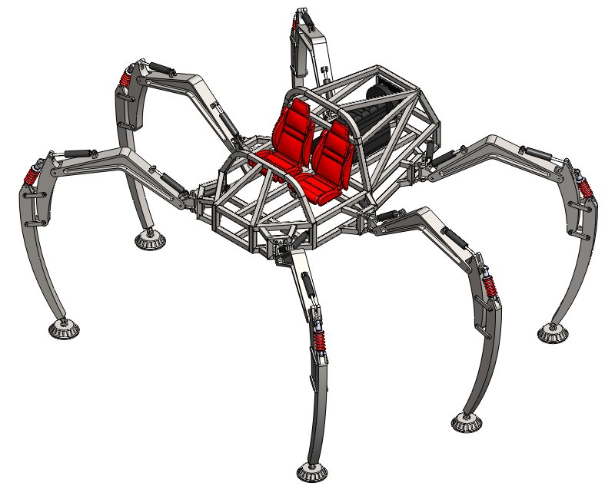
Mobile Robotics
Robot Hardware

Slide 2
Robot Hardware
Actuators / Motors
Sensors
Computation/Communication
Power

Slide 3
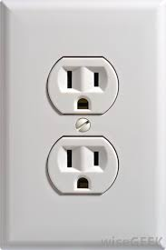
With Great Power
Primary Hardware Concern
Trade off: Batteries vs. Cords

Slide 4
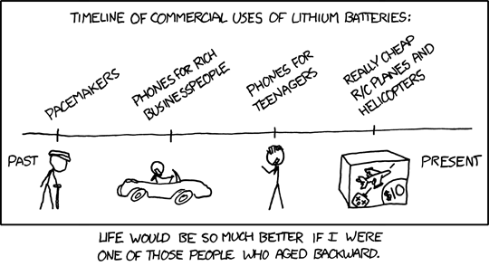
Batteries
Heavy
Hazardous: lead/acid technology
Limited Life Span
Swapping
Batteries
Recharging

Slide 5
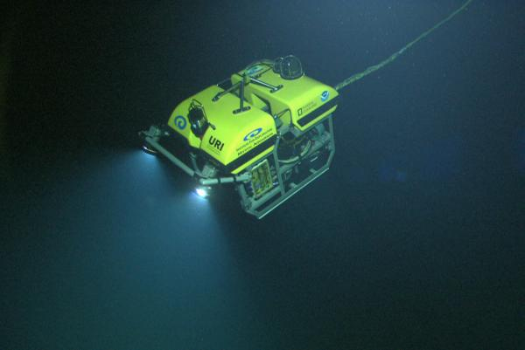
Tethered Robots
Effectively unlimited power
(and communication)
Very little weight
Limits Range
Limited
Environments

Slide 6
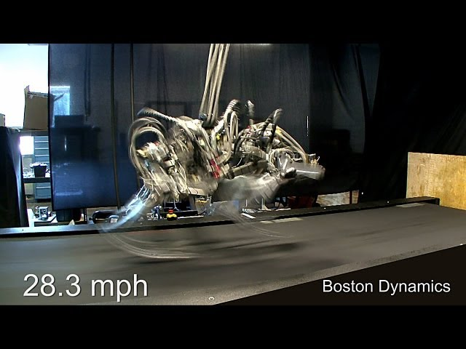
Boston Dynamics Cheetah

Slide 7
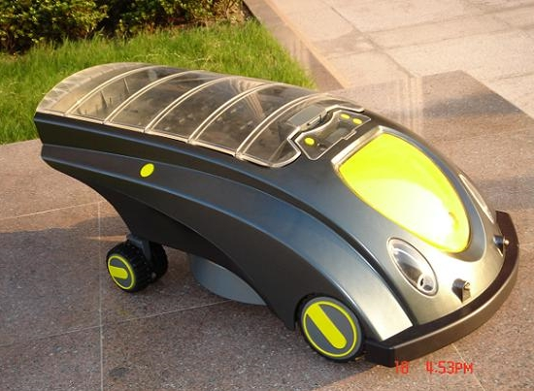
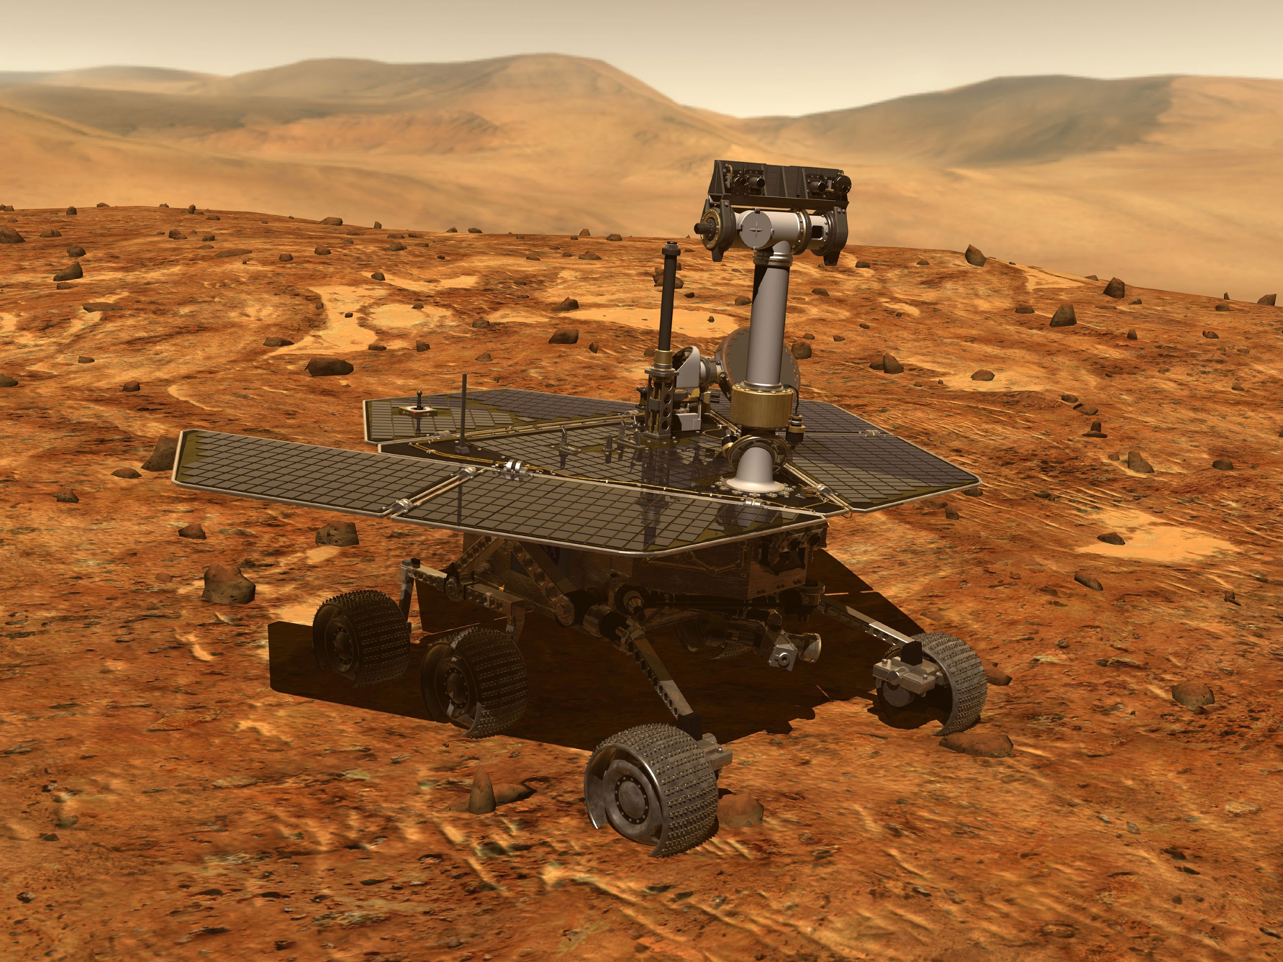
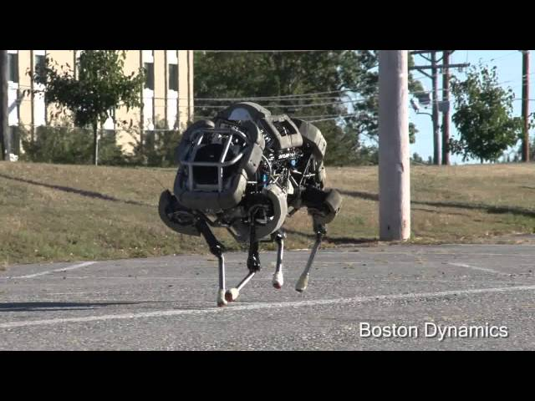
Other Options
Solar
Internal Combustion

Slide 8
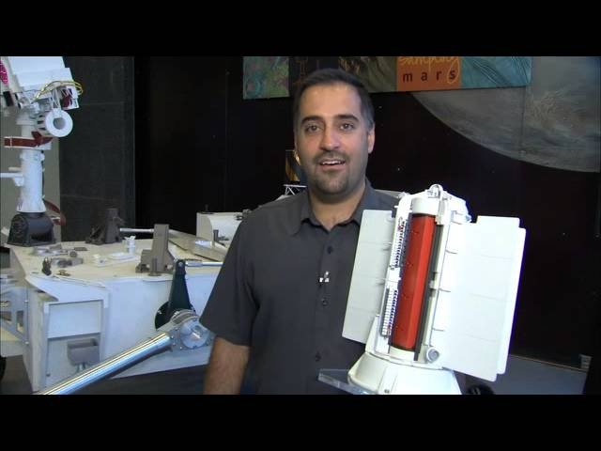
More Options
Radioisotope Themoelectric Generator

Slide 9

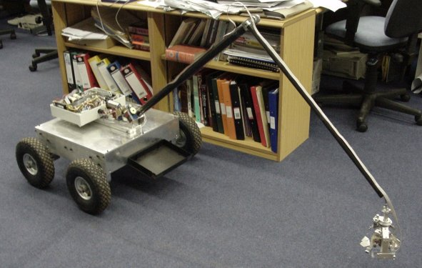
Biological Power

Slide 10
Locomotion Systems
Wheels
Legs
Propellors/Wings
Thrusters/Jets

Slide 11
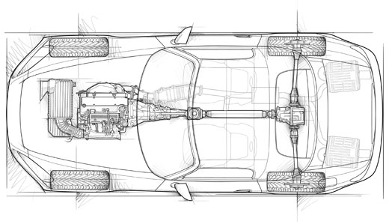
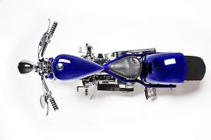
Stability
Static Stability - can balance without being active
Dynamic Stability - Needs active control to stay upright (stable when moving)

Slide 12
Stable Configurations
Projection of the center of mass must fall within the support polygon

Slide 13
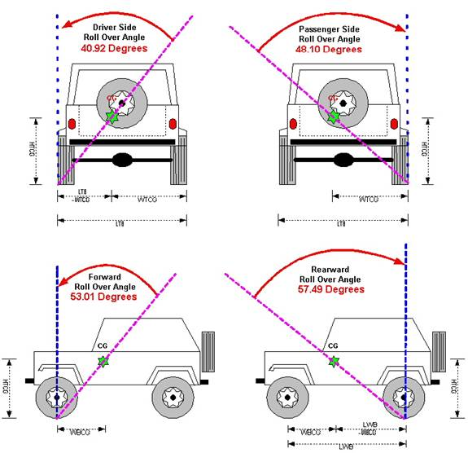
Jeep Rollover

Slide 14
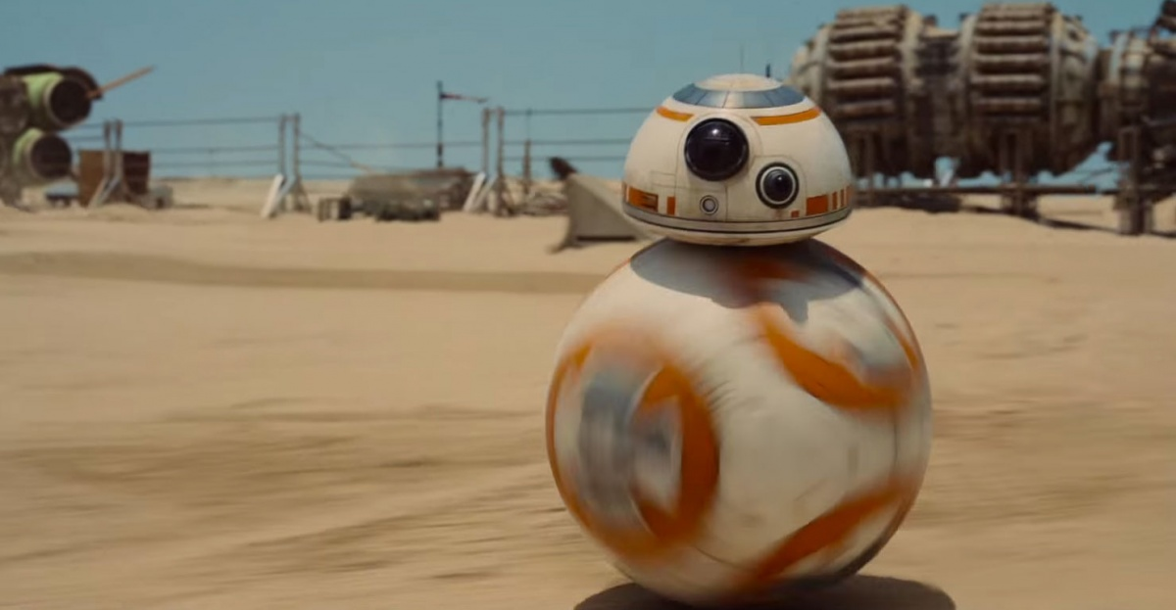
The Wheels on the Bot
Active or Passive
Fixed or Free
Type of Wheel
Configurations

Slide 15
Ackerman Steering - Four Wheels
Two Active Fixed Wheels in Back
Two Passive Steerable Wheels in Front

Slide 16
Bike Steering - 2 Wheels
One Active Fixed Wheel in Back
One Passive Steerable Wheel in Front

Slide 17
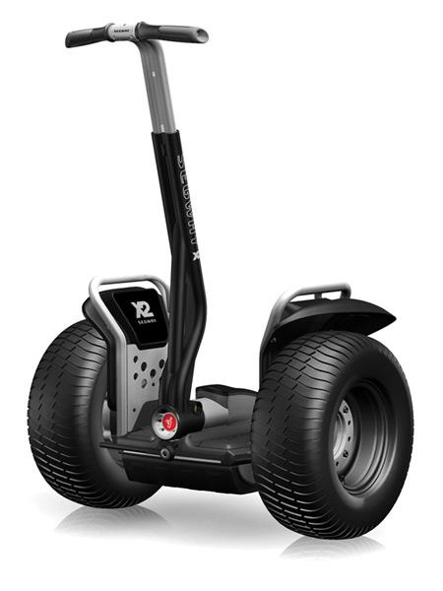
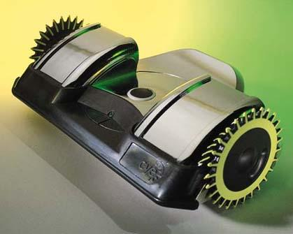
Segway - 2 Wheels
Cye Personal Robot
Two Active Wheels
Center of Mass below Axle

Slide 18
Differential Drive
Equal Wheel Velocity
Top Wheel Faster
Forward Kinematics
(more on this later)

Slide 19
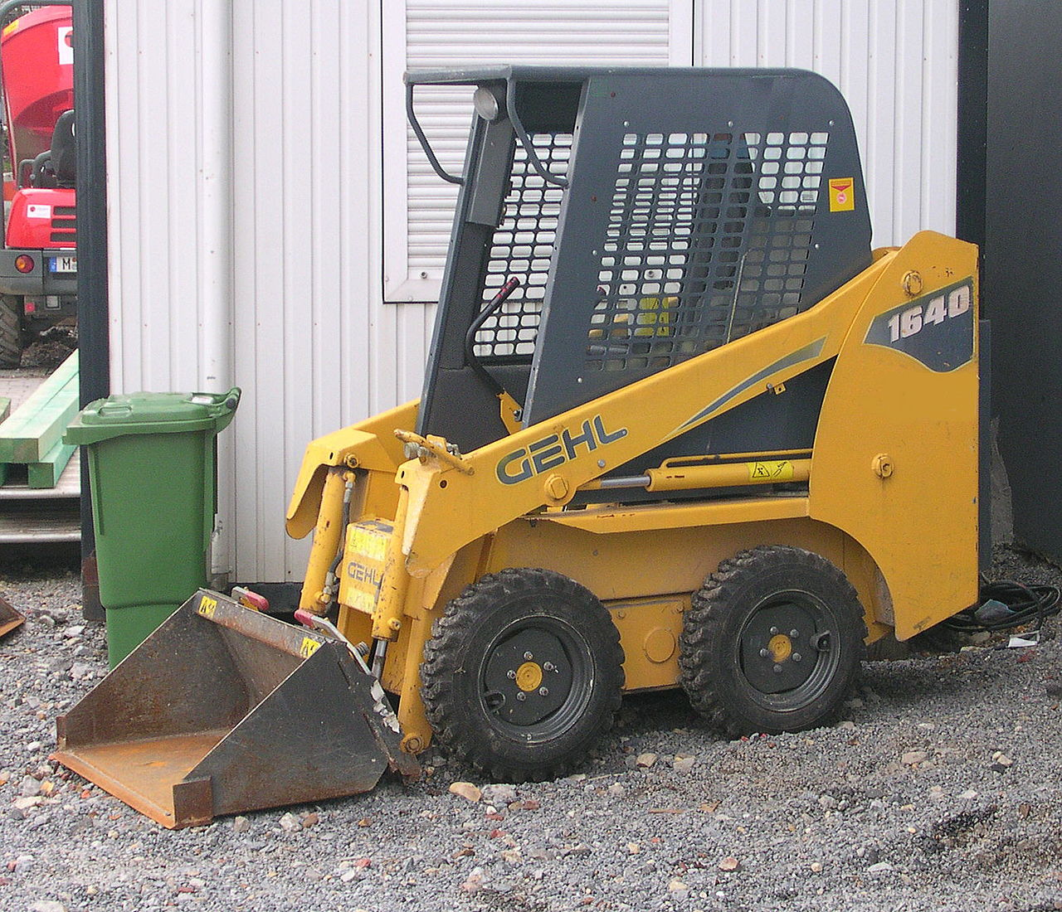
Skid Steering - Four Wheels
Four active fixed wheels

Slide 20
Two+One - Three Wheels
Two Active Fixed Wheels in Back
Point of Contact / Castered Wheel in front

Slide 21
Turtlebot
Two Active Wheels
One Caster Wheel
One Passive Wheel

Slide 22
PR2 - Four Wheels
Four steerable active wheels

Slide 23
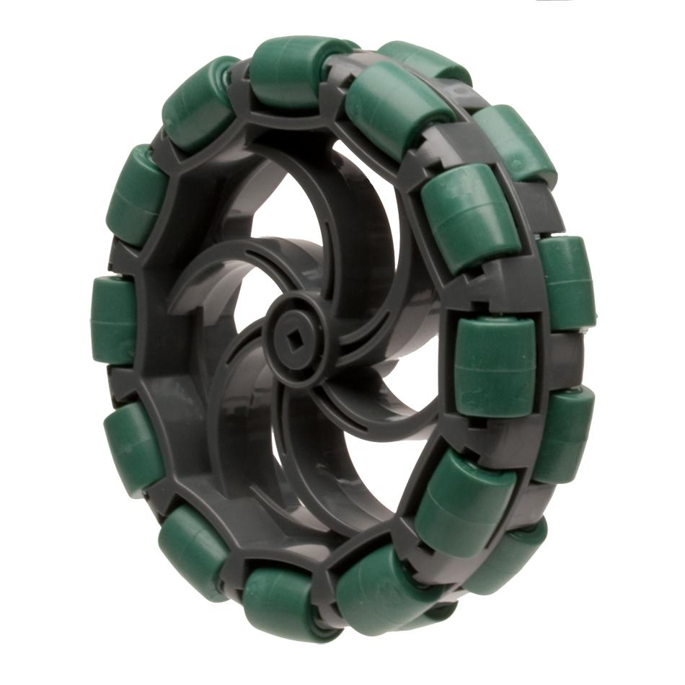
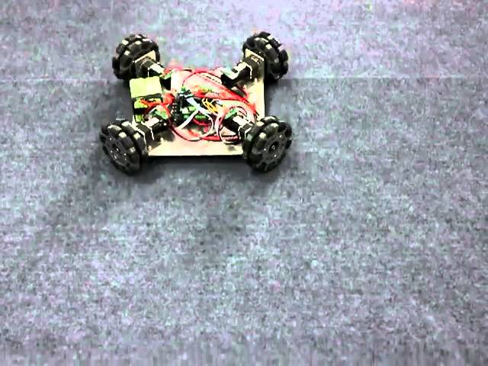
Omniwheels
Slide Laterally With Ease

Slide 24
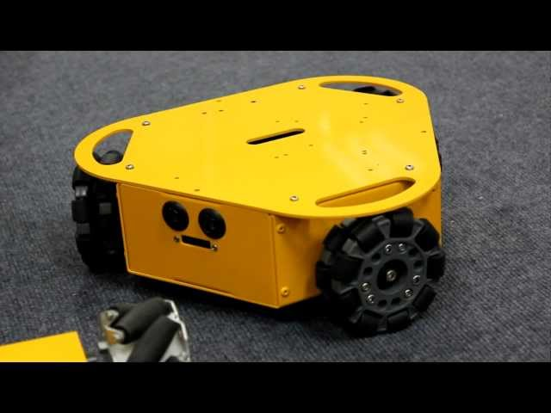
Three Omniwheels

Slide 25
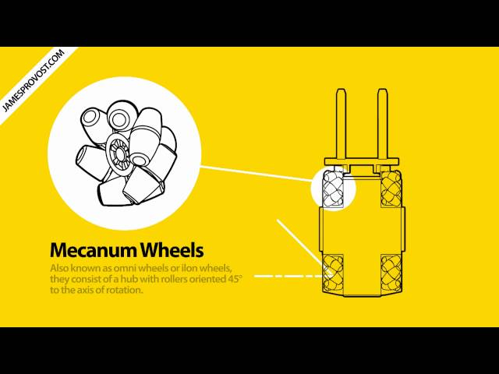
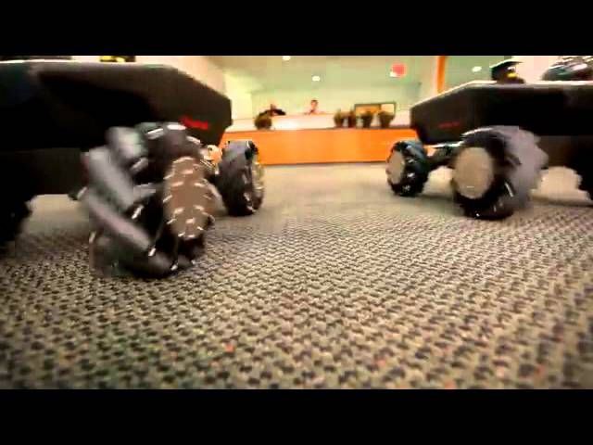
Swedish / Mecanum Wheels

Slide 26

The World is Flat!

Slide 27
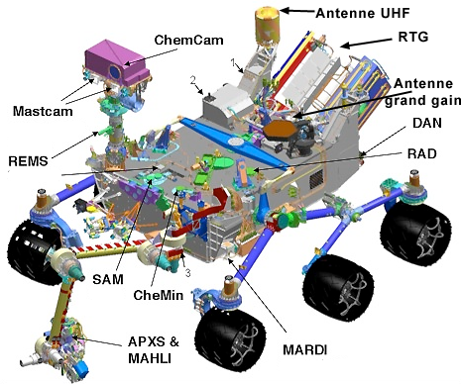
Rocker Bogie - Six Wheels

Slide 28
Legs
Can Deal with Rough Terrain
Quality of Ground Matters Less
Can Cross Holes
Power Needs
Mechanical Complexity
More complex kinematics

Slide 29
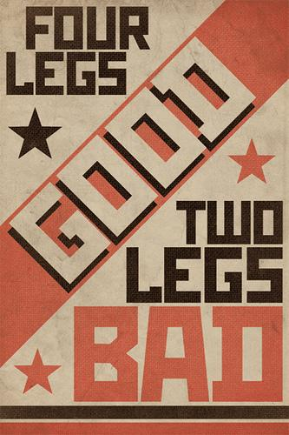
Number of Legs

Slide 30
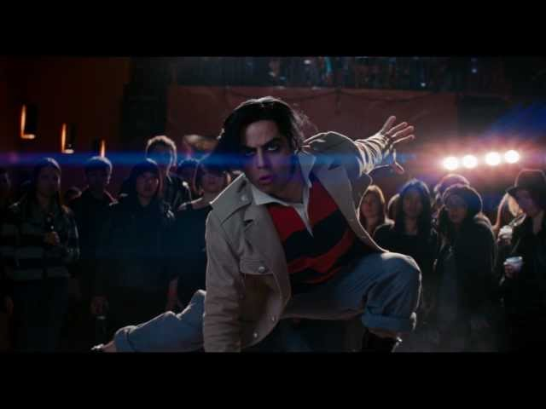
Three Points!

Slide 31

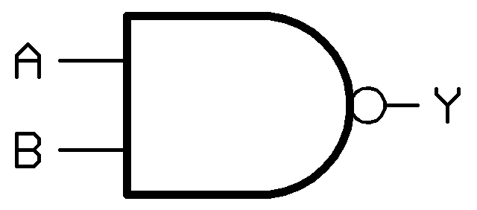
Gaits
Order/sequence of legs and
their specific control

Slide 32
Walking with Four Legs

Slide 33
Walking with Six Legs

Slide 34
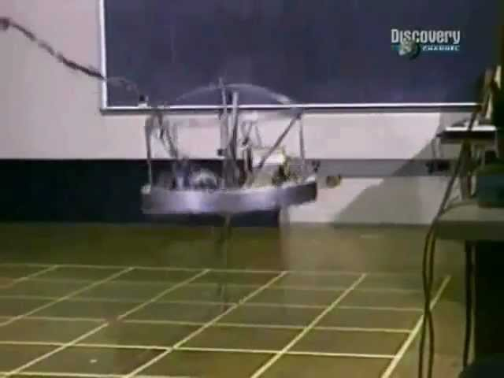
Walking Robots

Slide 35
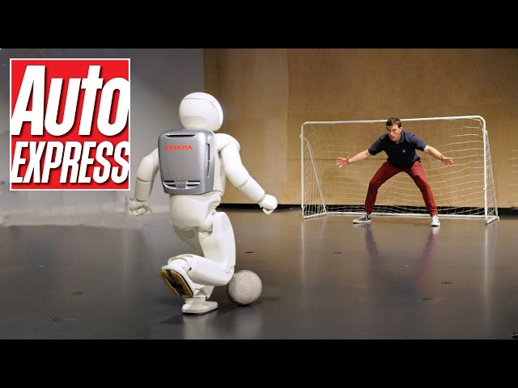
Honda Asimo

Slide 36
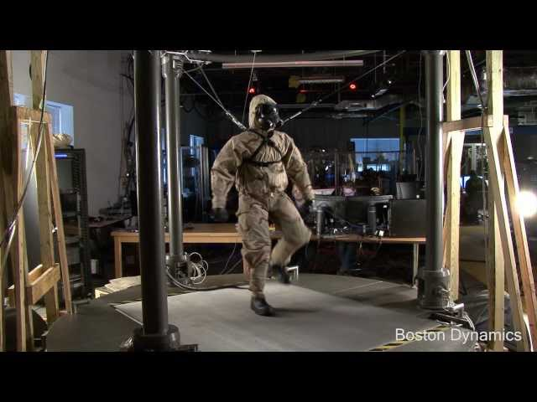
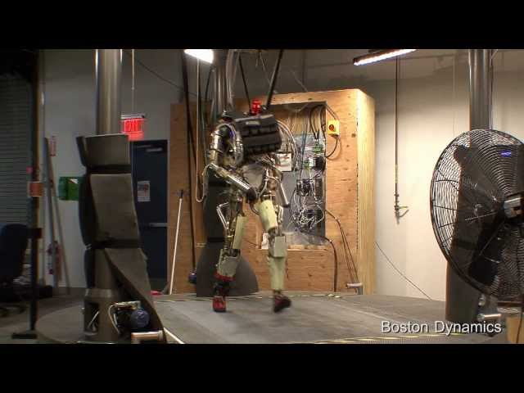
Boston Dynamics Petman

Slide 37
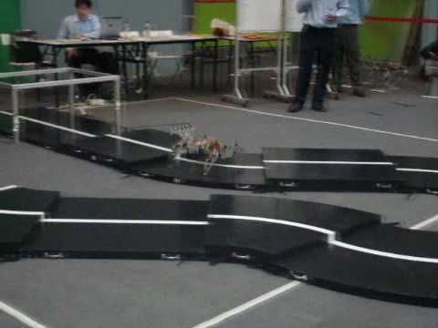
4+ Legs

Slide 38
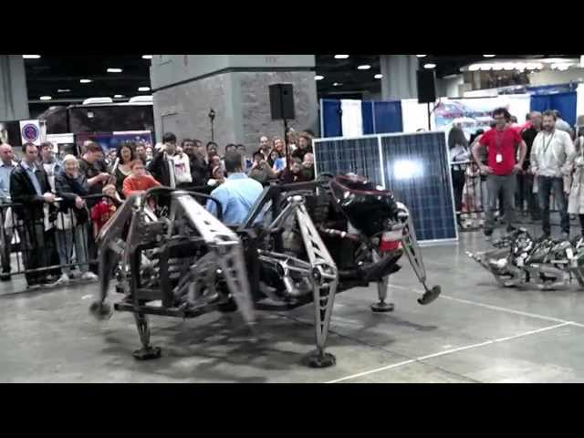
Spider Robot

Slide 39
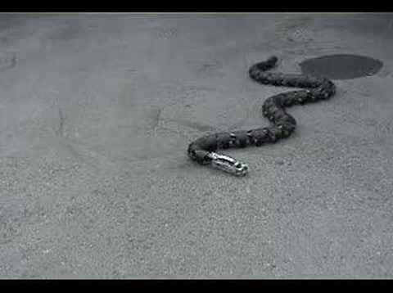
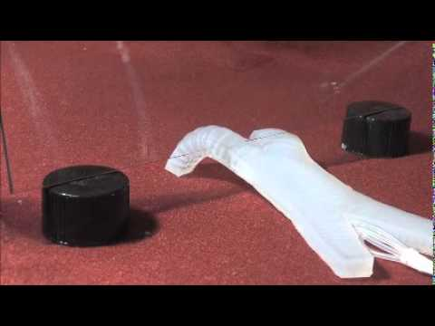
Other Robot Mobility
Sliding
Crawling
Fixed Wings
Rotary Wings

Slide 40
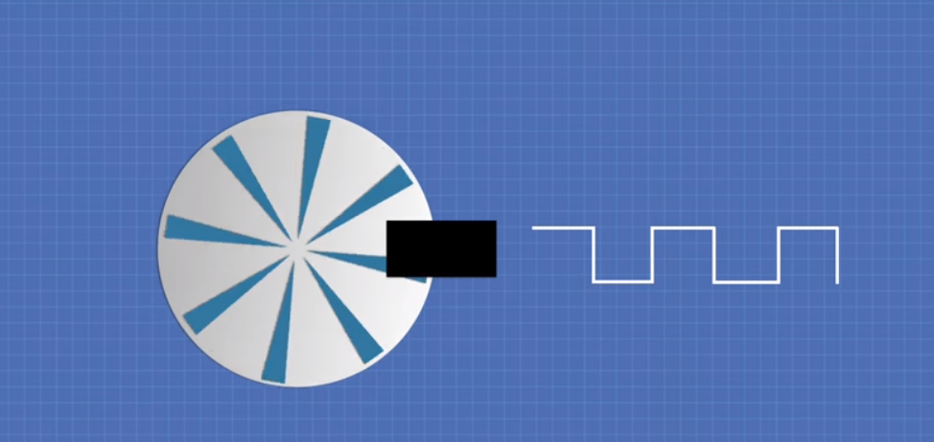

Slide 41
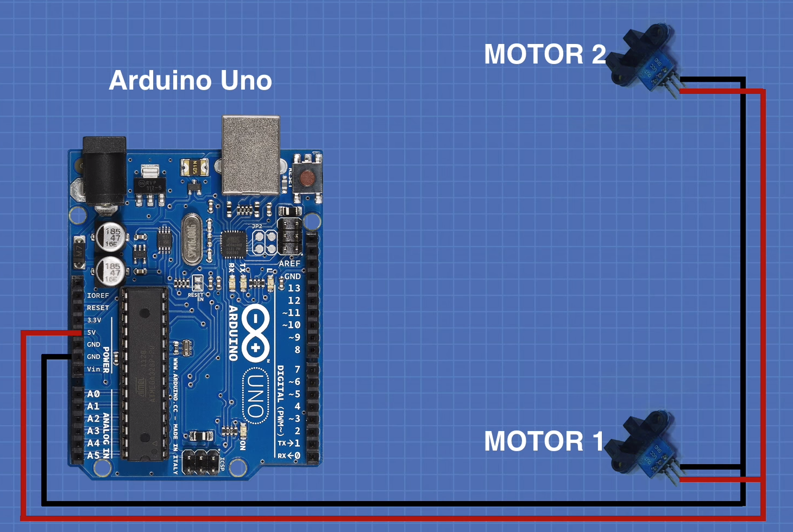

Slide 42
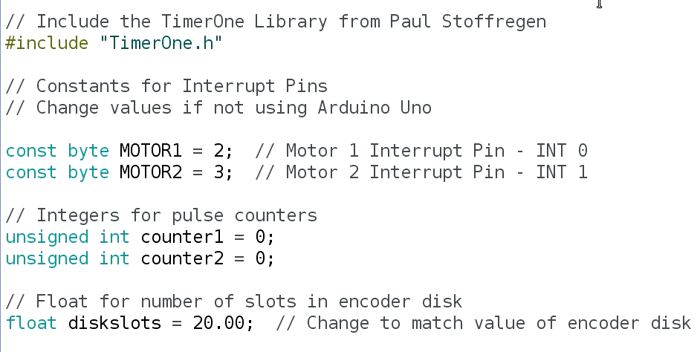

Slide 43
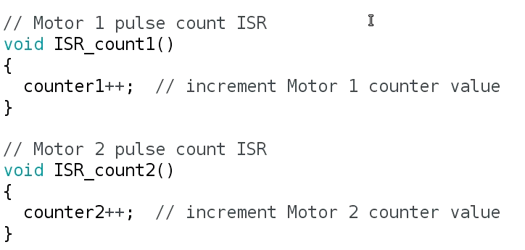

Slide 44
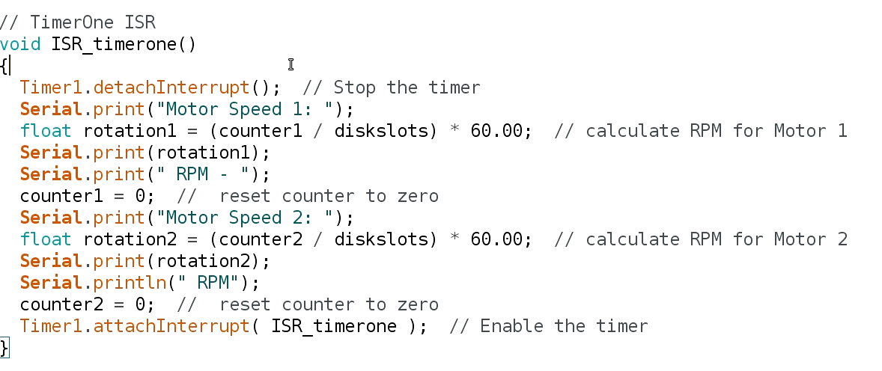

Slide 45
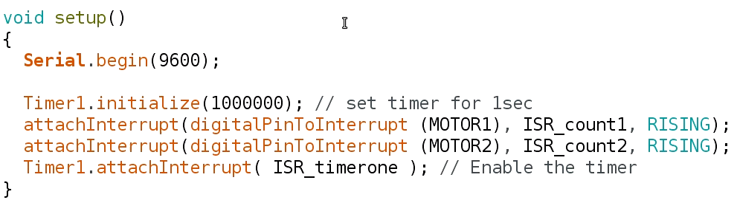

Slide 46
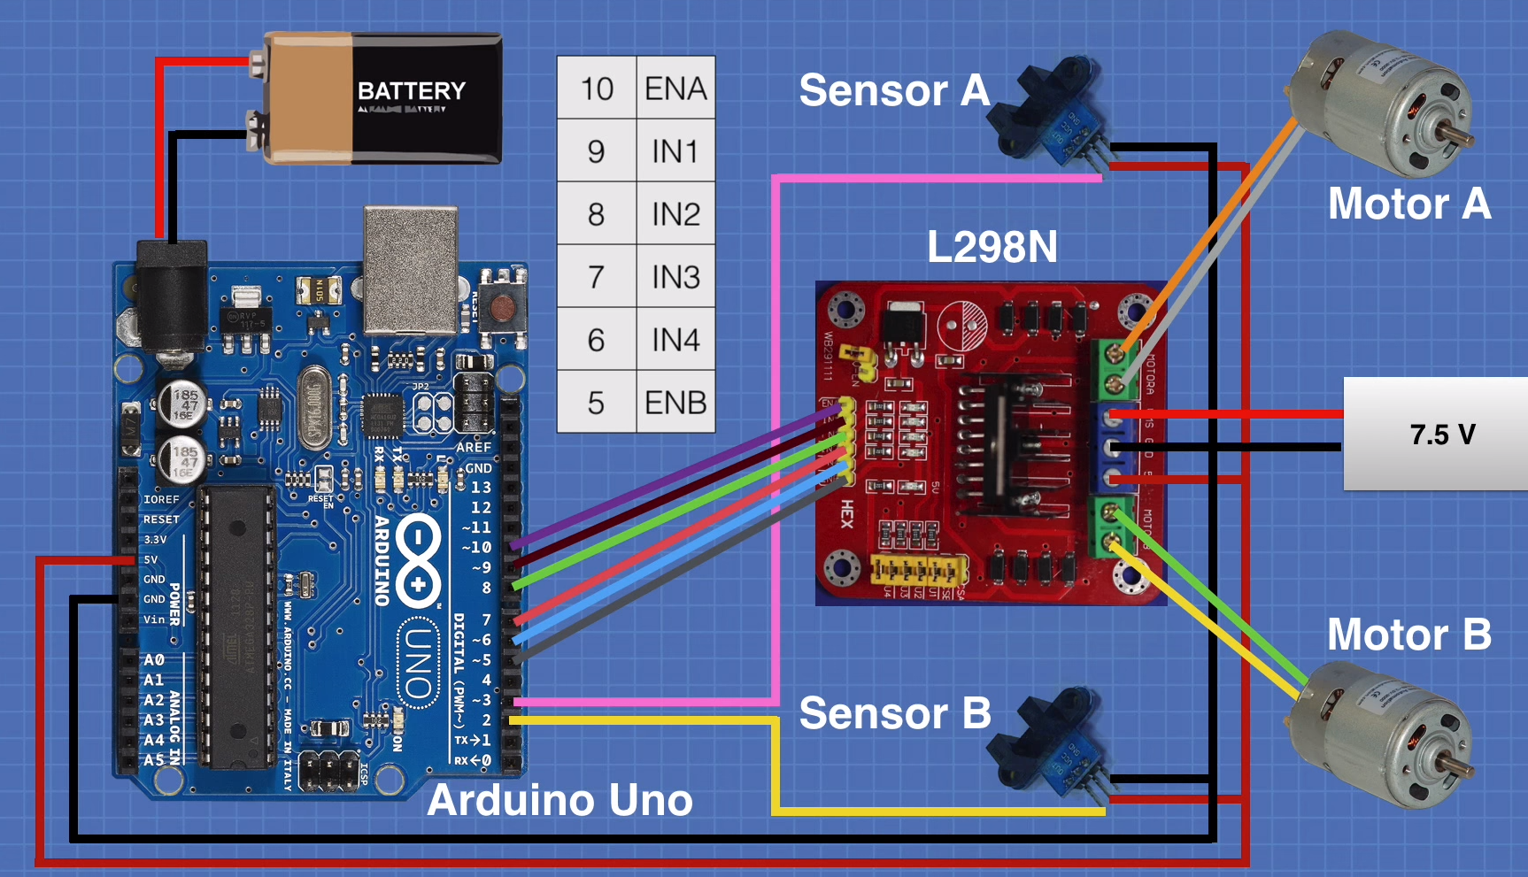

Slide 47
Connect raspberry

Slide 48
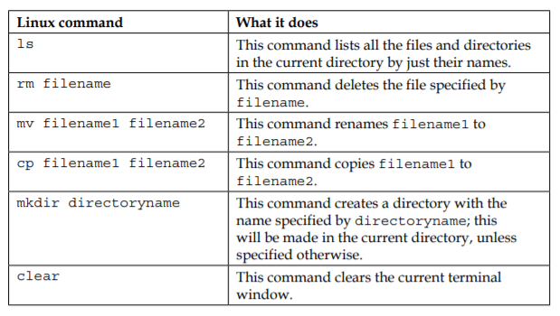

Slide 49
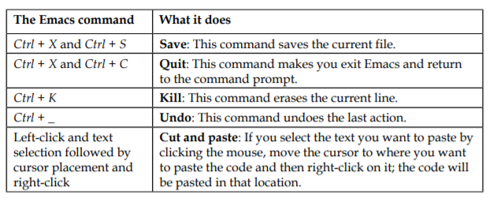

Slide 50
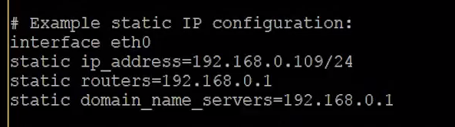
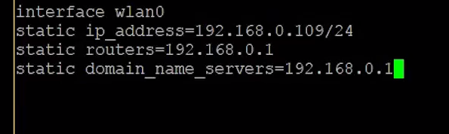
Raspberry ip fixed
Ipconfig
sudo nano /etc/dhcpcd.conf

Slide 51
Ctrl O
sudo reboot

Slide 52
Option 2
Old

Slide 53
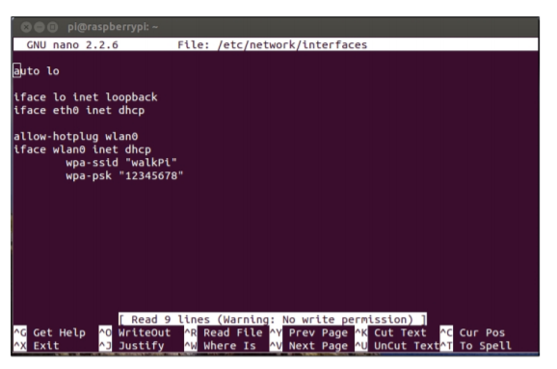
sudo nano /etc/ network/interfaces

Slide 54
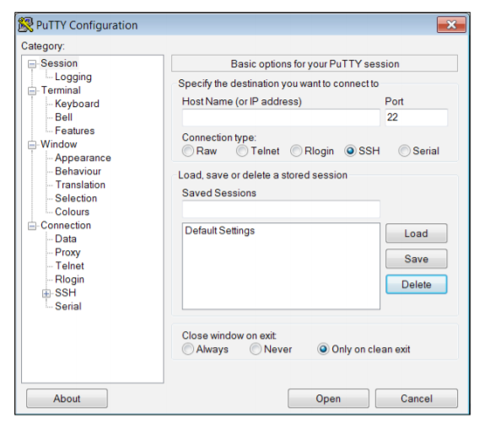
PuTTY

Slide 55
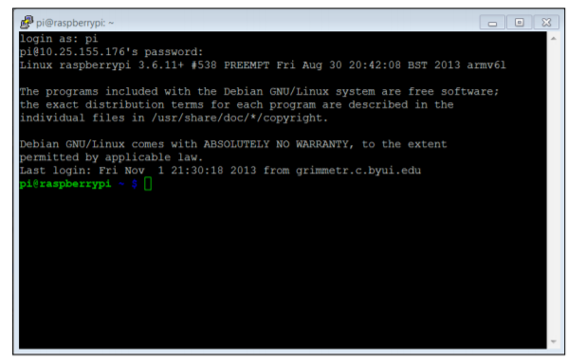
Login: pi password: raspberry

Slide 56
Install tightvncserver
sudo apt-get install tightvncserver
sudo apt-get install xtightvncviewer

Slide 57
On terminal
tightvncserver

Slide 58
Optionals
https://www.youtube.com/watch?v=cBjKw_u06tA
https://raspberryparatorpes.net/instalacion/poner-la-direccion-ip-fija-en-raspbian-pixel/

Slide 59
VNC

Slide 60
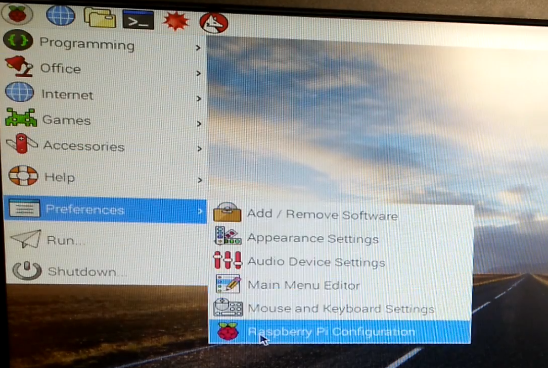

Slide 61
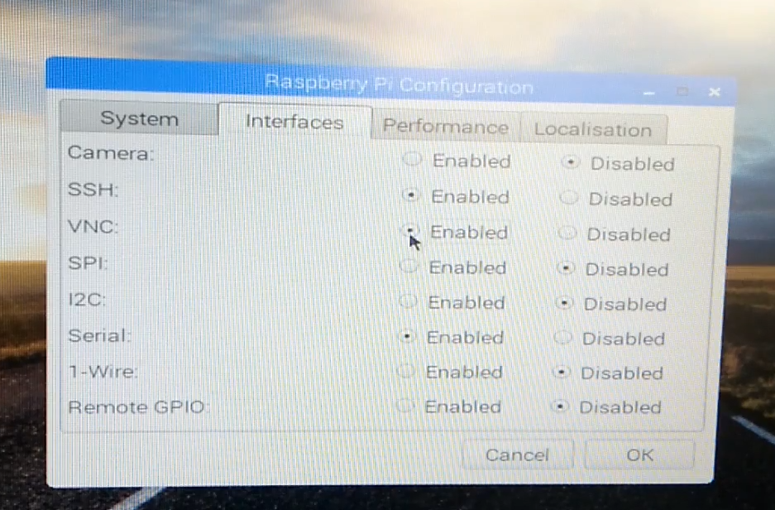

Slide 62


Slide 63


Slide 64


Slide 65

Poor Resolution

Slide 66

Old version( on review)

Slide 67
Documentation configure
https://www.raspberrypi.org/documentation/configuration/config-txt/README.md

Slide 68
GPIO

Slide 69


Slide 70

H-Bridge connection

Slide 71
Raspberry pins
https://pinout.xyz/

Slide 72
Option 1
RPI GIPIO

Slide 73
Install
$ sudo apt-get update $ sudo apt-get install python-rpi.gpio python3-rpi.gpio
https://sourceforge.net/p/raspberry-gpio-python/wiki/install/

Slide 74
OPTION 2
GpioZero(Recommended)

Slide 75
Documentation
https://gpiozero.readthedocs.io/en/stable/recipes.html#keyboard-controlled-robot

Slide 76


